Slide 1

A Project on
“University Complaint Management System”
For the degree of MSCSE (Professional)
Presented by:
Shaikh Md. Shahidul Islam
ID: M240105052
Batch: 15th
Supervised By:
Dr. Md. Zulfiker Mahmud
Professor
Department of CSE
Jagannath University, Dhaka

Slide 2
Introduction
UCMS WORKFLOW
Submit complaint
What is UCMS?
A web-based complaint management platform
Designed for universities and educational institutions
Enables students to submit complaints digitally
Provides transparent tracking and resolution workflow
Improves communication between students and administration
Assign department
Review and resolve
Close with feedback
VISIBLE STATUS AT EACH STEP
COMPLAINT LIFECYCLE
Why Needed?
Traditional complaint handling is slow
Lack of accountability
Complaints get lost or ignored
No centralized monitoring system
Difficult to maintain records manually
1
2
3
4
Submitted
Assigned
In progress
Resolved

Slide 3
Existing Problems in Traditional System
Student Side
No proper complaint tracking
Delayed responses
Lack of transparency
Fear of complaints being ignored
WHERE THE TRADITIONAL PROCESS BREAKS
01
Paper records
Files are difficult to track and compare
02
Manual forwarding
Complaints may wait between offices
Administrative Side
Huge paperwork
Manual forwarding process
Difficult monitoring
No centralized reporting
Repeated complaints difficult to identify
03
No shared status
Students cannot see current progress
04
Weak reporting
Repeated issues remain difficult to identify
Delay • Limited accountability • Repeated follow-up

Slide 4
Objectives of UCMS
Primary Objectives
Digitize complaint management process
Ensure faster complaint resolution
Increase transparency and accountability
Centralize complaint records
OBJECTIVES LEAD TO ONE OUTCOME
Digitise
Online submission and central records
Route
Department assignment and status control
Secondary Objectives
Improve communication
Generate analytical reports
Reduce manual workload
Enhance student satisfaction
Create auditable complaint history
Monitor
Reports, history and accountability
FASTER AND TRACEABLE COMPLAINT RESOLUTION

Slide 5
Proposed Digital Solution
UCMS COMPLAINT MANAGEMENT CYCLE
UCMS Provides
Online complaint submission
Complaint categorization
Automated routing system
Department-wise management
Real-time status tracking
Notification system
Feedback and resolution mechanism
Submit
Categorise
1
2
Student
System
3
Assign
4
Update
Administration
Officer
5
Review
6
Close
Platform Access
Web-based responsive application
Accessible from mobile and desktop devices
Secure login-based system
Administration
Student feedback
Every action is recorded in the complaint history

Slide 6
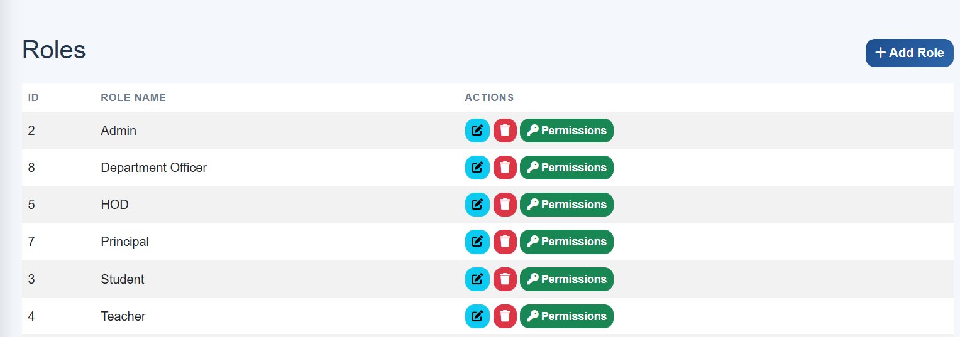
User Roles in UCMS
Student
Submit complaints
Track complaint status
Upload evidence/documents
Provide feedback
Department Officer
Review assigned complaints
Update complaint progress
Communicate with students
Resolve issues
University Administration
Monitor overall activities
Generate reports
Assign responsibilities
Evaluate departmental performance
Super Admin
User management
System configuration
Role & permission control
Full monitoring access

Slide 7
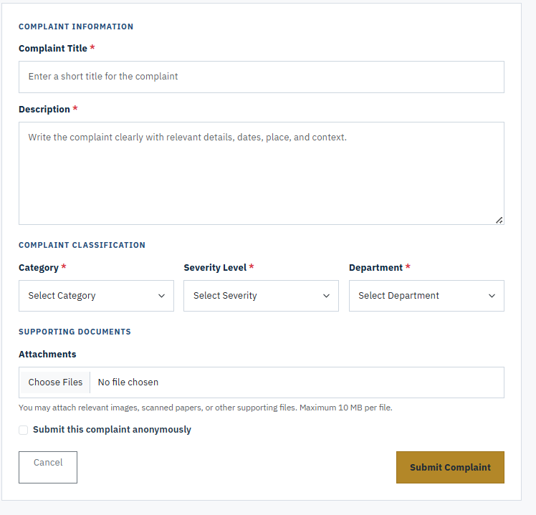
Core Features of UCMS
Complaint Management
Complaint submission form
Category & priority selection
File attachment support
Workflow Features
Automated complaint assignment
Status-based processing
Resolution tracking
Monitoring Features
Dashboard analytics
Department-wise statistics
Pending & resolved reports
Security Features
Role-based access control
Secure authentication
Activity logs

Slide 8
Complaint Lifecycle
COMPLAINT RESOLUTION FLOW
Step-by-Step Process
Student submits complaint
System generates unique complaint ID
Complaint routed to responsible department
Officer reviews complaint
Investigation & communication process
Resolution provided
Student feedback collected
Complaint closed
1
Submit
2
Reference ID
3
Department
4
Officer review
5
Resolution
Benefits
Transparent workflow
Reduced delay
Better accountability
6
Feedback

Slide 9
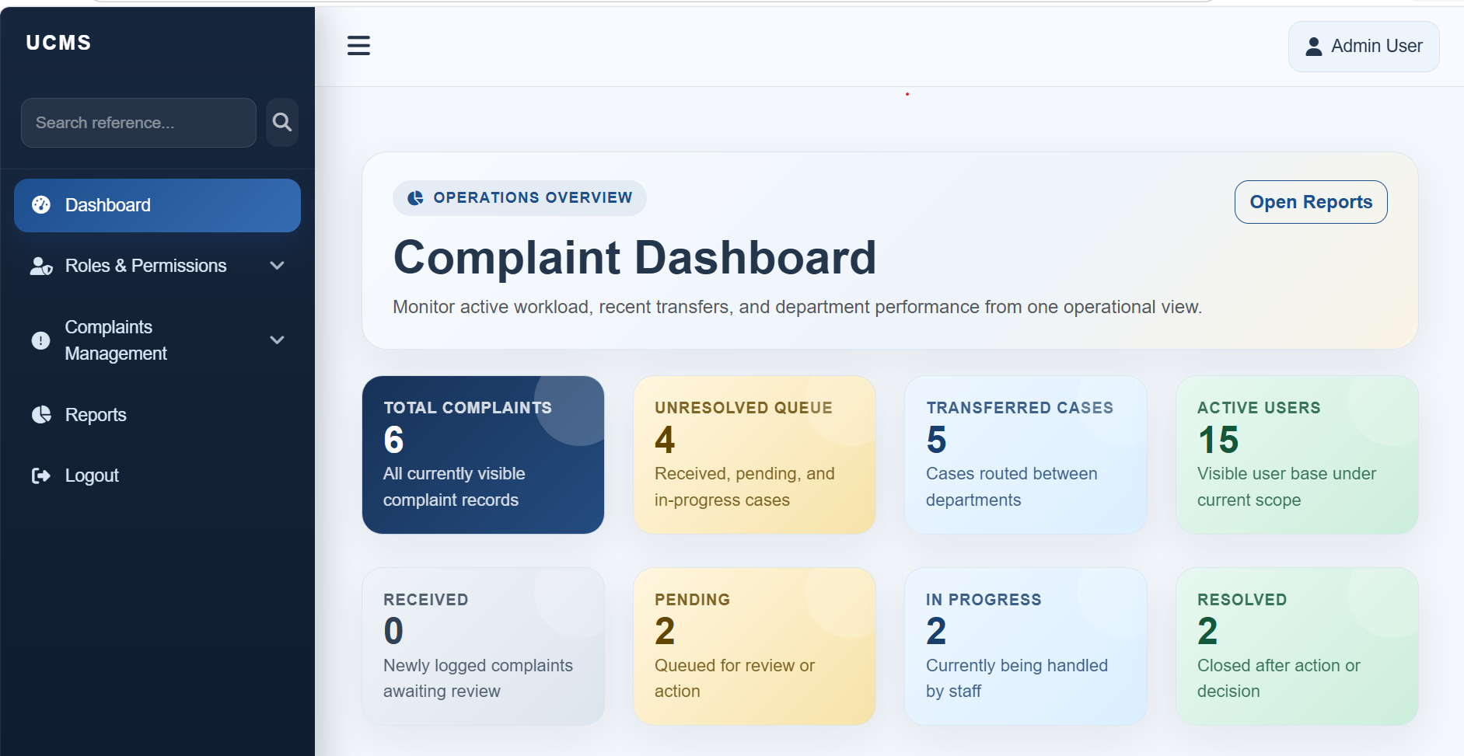
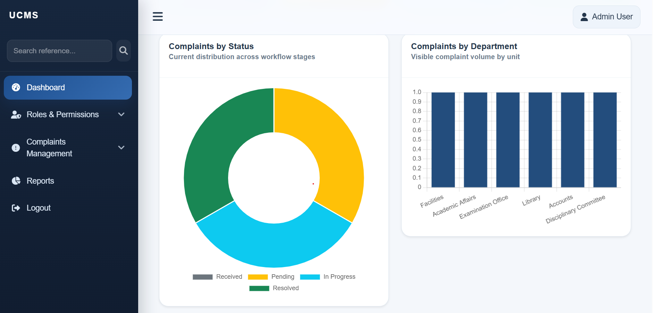
Dashboard Overview
Administrative Dashboard Includes
Total complaints overview
Pending complaints count
Resolved complaints count
Priority-based complaint statistics
Department-wise performance indicators
Recent complaint activity logs
Dashboard Benefits
Quick monitoring capabilities
Faster decision making
Improved operational management
Better resource allocation

Slide 10
Technologies Used
Frontend Technologies
HTML5
CSS3
JavaScript
Bootstrap
Additional Components
Authentication System
Role-Based Access Control (RBAC)
Responsive User Interface
Backend Technologies
PHP
Laravel Framework
Database
MySQL Relational Database

Slide 11
Benefits of the System
Benefits for Students
Easy complaint submission process
Faster response and resolution
Real-time tracking facility
Improved communication transparency
ONE SYSTEM, THREE BENEFICIARIES
STUDENTS
ADMINISTRATION
Simple submission
and visible status
Assignment, monitoring
and reports
Benefits for University Administration
Reduced paperwork and manual effort
Better complaint monitoring capabilities
Improved accountability and reporting
Data-driven decision-making support
UCMS
Institutional Benefits
Enhanced operational efficiency
Improved institutional reputation
Better student satisfaction management
Transparent governance system
INSTITUTION
History, accountability
and service improvement

Slide 12
Challenges During Development
Technical Challenges
Designing workflow automation logic
Implementing role-based permissions
Managing complaint routing processes
Ensuring system security and data protection
Operational Challenges
User adaptability and training
Institutional policy alignment
Maintaining process consistency
Current Limitations
Internet dependency
Requires institutional adoption support
Currently available as a web application only

Slide 13
Future Development Plan
FUTURE DEVELOPMENT ROADMAP
Planned Features
Mobile application development
Email and SMS notification integration
AI-based complaint categorization
Smart routing recommendations
Live chat support system
Single Sign-On (SSO) integration
Student information system integration
STAGE 1
STAGE 2
STAGE 3
Strengthen
Connect
Extend
Email/SMS alerts
Mobile application
SSO integration
Live support
AI categorisation
Cloud deployment
Long-term direction
Long-Term Vision
Multi-campus implementation
Cloud-based deployment
Adaptation for multiple educational institutions
Multi-campus use • Better accessibility • Adaptation for other institutions

Slide 14
Queries
Demonstration URL
https://ucms.codeexpress.net/

